Slide 1
http://info-ted.eu/

Slide 2
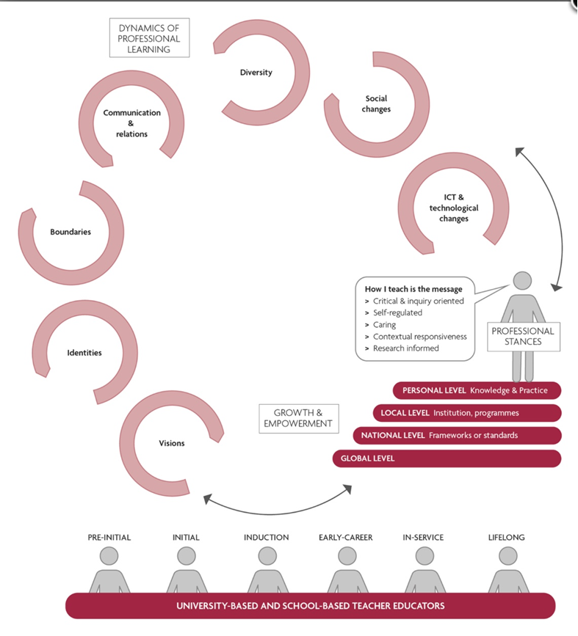
Onderzoek http://info-ted.eu/conferences/ http://info-ted.eu/publications/ Open Teacher Educator Portal http://info-ted.eu/knowledge-bases/ http://info-ted.eu/blog/ Summer Academy (professional development activities) http://info-ted.eu/forum/ Co-operation http://info-ted.eu/events/

Slide 3
Open Teacher Educator Portal
Knowledge bases/Blogs

Slide 4
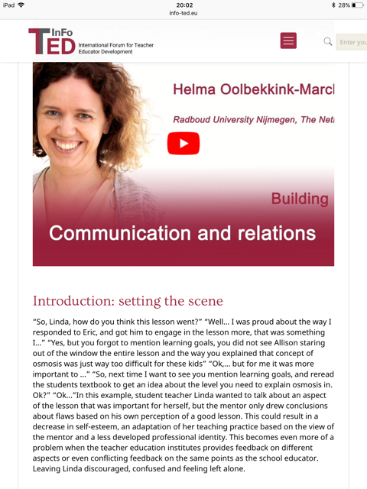
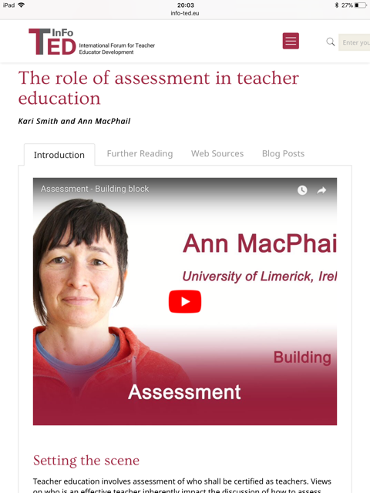
Introductions and Further Reading

Slide 5
Web Sources en Blogs
Web Sources: worden verzameld
Idee voor een blog? Ruben.Vanderlinde@UGent.be mieke@lunenberg.info

