Slide 1
Professional Learning for European Higher Education-Based Teacher Educators: Addressing Issues of Pan-European Practices and Policies
ECER 2018, Central & EERA Session: 00 SES 08
Network Co-ordinators: ML White (N10) Ken Jones (N1) Petra Grell (N6)
InfoTED Council: Jean Murray Ann MacPhail Ruben Vanderlinde
Chair: Lin Goodwin

Slide 2
Rationale and formats for council session
Introduction and rationale: Jean Murray & ML White
InFo-TED’s Concepts of Professional Learning: Ruben Vanderlinde
Implementation of the concepts: Ann McPhail
Audience discussion
Comments: Ken Jones N1 and Petra Grell N6
Audience discussion
Reaching out to Policy Makers: advice and comments

Slide 3
Teacher educators’ complex roles
Experts on teaching and learning
Teaching adult learners in higher education institutes
Teaching how to teach (and how to teach teachers)
Mediating between academia, schools and communities
Aligning visions and values with educational practices
Adopting critical and inquisitive stance to improve their work
Engaging in research and development
Need to accommodate to rapid and substantial socio-economic and educational changes

Slide 4
Teacher educators and the inclusion/exclusion conundrum
Teacher educators are central in education
Arguments for inclusion and influence strong
But often flying ‘beneath the radar’ of policy makers
Often seen as outsiders in the world of the university
‘Inside / outside the ivory tower’ (Maguire, 1994)
Or located in colleges of education, polytechnic universities
Research in and on teacher education – who researches what when and why
How is that research judged in wider academic communities

Slide 5
InFo-TED
International forum for Teacher Educator Development
Goal: to exchange and promote research, policy and practice on teacher educators’ professional development

Slide 6
Partners

Slide 7
Conceptual model
Background: recent attention (from policy, research and practice) for teacher educators and their professional development
First goal of Info-TED: establishing a common language to discuss teacher educators’ professional development
Desciptive model: no normative model or blueprint approach

Slide 8
Conceptual model
Starting point for professional development = teacher educators’ practices
Dual level: teachers of teachers with ‘teaching’ as their ’teaching subject’
Second-order practitioners
How I teach is the message
Importance of having a reflective and research attitude (professional stances)

Slide 9
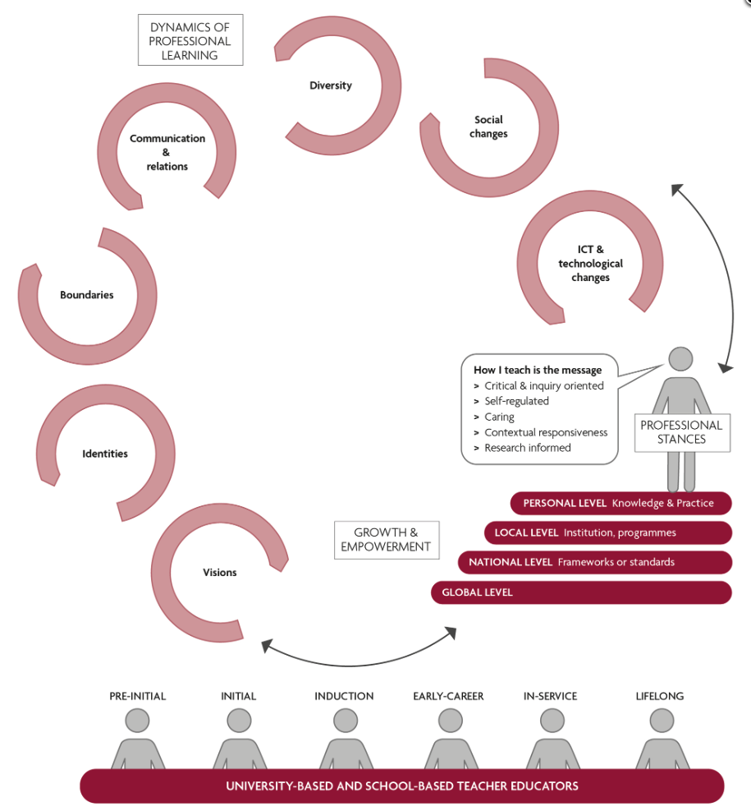

Slide 10
Starting point:
‘How I teach is the message’
Messages as reflections of his/her stance in the profession
Model teaching

Slide 11
Situated in:
Personal level (knowledge and practices)
Local level (institution, programmes)
National level (frameworks or standards)
Global level

Slide 12
Dynamics of professional learning
Non-exhaustive list of content domains (opportunities for professional development)

Slide 13
Broad definition of teacher educators: school-based (mentors) and university-based (lecturers and professors)
EU: ’All those who actively facilitate the (formal) learning of student teachers and teachers’

Slide 14
Professional development: related to different career stages
Career paths and stage
Individual biography

Slide 15
Info-ted.eu
Aims
Publications
Events
Knowledge bases
Blogs
Conferences
Council members

Slide 16
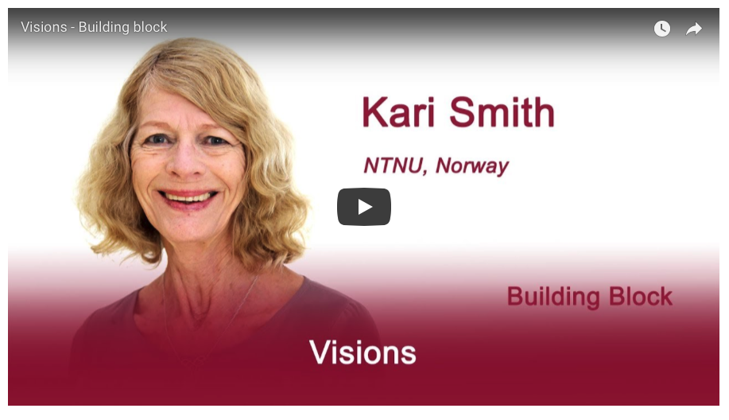
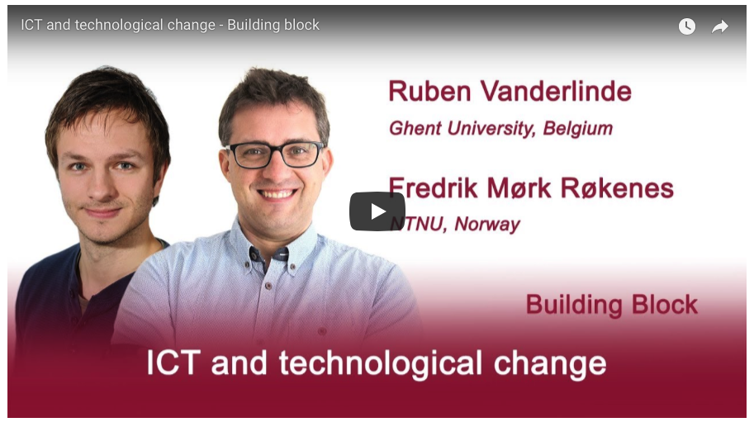
Website and building blocks
Knowledge base: 13 building blocks
Same structure:
Introduction page
(and video)
Suggestions for further
reading
Web resources
Related blogs

Slide 17
Website and building blocks
ICT and technological change
Social change
Diversity
Research
Assessment
Communication and relations
Boundaries
Identities
Visions
How I teach is the message
Personal, local, national and global
Stages of professional development
University and school-based TE

Slide 18
Blogs
Contributions from Teacher Educators
On the InFo-TED website
500/750 words
Summaries of research
Opinion pieces
Responses to TE
policies
Description of TE
(good) practices
Reflective learning as TE
…

Slide 19
Summer academy
Encourage collaborative research and professional development work among teacher educators in Europe
Disseminate the ideas of the International Forum for Teacher Educators’ Professional Development
Present and discuss a conceptual model on Teacher Educators’ Professional Development
Network and broaden the empowerment of teacher educators as a European group
Contribute to teacher educators professional development

Slide 20
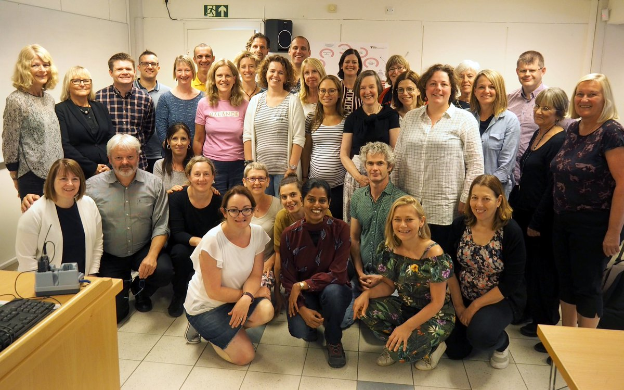
Summer academy
NTNU, Trondheim, July 2-6 2018
25 participants (from Belgium, England, Ireland, Israel, Netherlands, Norway, Scotland) and InFo-TED Council members
Programme included getting to know each other, formal delivery, time to digest what they had heard / revisit and progress reflections, innovative activities, collaboration, future intentions

Slide 21
Synergies between the two
Summer Academy Forum
Phased introduction
Welcome lounge
Notes:
Summer Academy Forum section of the InFo-TED website. This is a private space - open and visible (unlike the rest of the website) to only colleagues attending the Summer Academy and to Council members
Phased introduction to the related features
Welcome lounge includes biographies, understanding our contexts, readings and source materials, invitation to blog, opportunity to raise any questions

Slide 22
Questions for discussion
What support structures are needed to allow for teacher educators’ professional development?
Which policies can achieve more balanced attitudes towards upscaling pedagogical and research related skills? How can an integrated approach to research and pedagogy be encouraged?
What are the most important domains for professional development required by current changes in Europe?
Taking into account the differences among countries: how can we further stimulate collaborative learning?

