Slide 1
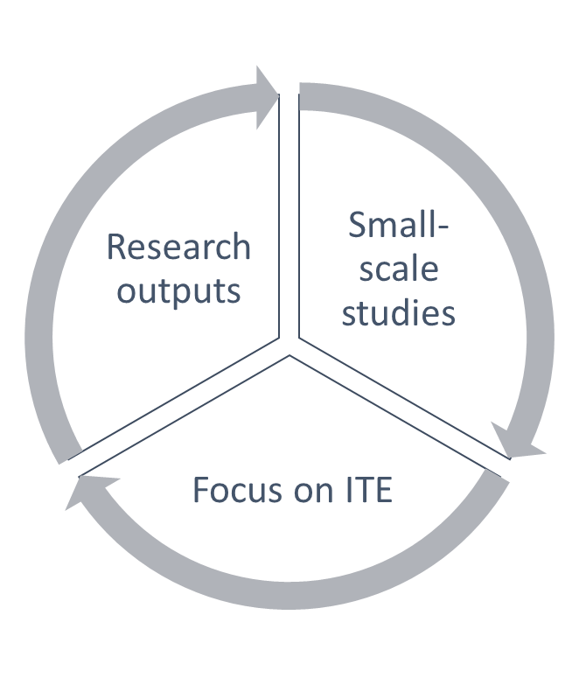
The use, conduct and role of research: Higher-education based teacher educator-researchers in Ireland
Ann MacPhail, University of Limerick, Ireland
INTRODUCTION
METHODS (continued)
RESULTS
CONCLUSIONS
Teacher education and research:
If teaching and teacher education are to be taken seriously, need to be research-based / informed / ‘public intellectuals’ (Coachran-Smith, 2005)
Re-positioning of teacher education and associated programmes to be ‘research driven’ / develop a research disposition / consumers and producers of research (Tack and Vanderlinde, 2014 )
Pressure from universities for teacher educators to focus on securing research funding and increase publication output (Stern, 2016)
‘dual economy’ – research and teaching (Christie & Menter, 2009)
Irish teacher education and research:
The recent policy context in Ireland has re-framed the role of teacher education and research (Gleeson et al., 2017). The joint influence of the more complete universitisation of teacher education recommended in the Sahlberg et al., report (2012), along with increased rankings pressure on universities, has meant that there is more pressure on Irish teacher education academics as they work in higher educational institutions to acquire a PhD and publish in peer-reviewed research outlets. Main recommendations from the International Review Panel (Sahlberg et al., 2012) were (i) to enhance teacher professionalism and practice by increasing the research capacity of providers of ITE, and (2) the development of critical mass of (research) teacher educators through reduction in number of institutions to form ‘centres of excellence of education’.
Three trends can be identified. First, the recent growth of research outputs on teacher education in Ireland over the last decade. Second, a small number of larger scale studies as well as a number of commissioned reports on teacher education which have provided more system level insights on teacher education. Third, there is more of a focus on initial teacher education than other elements of the teacher education continuum.
A total of 54 teacher educators, two-thirds of whom were female, responded to the survey with a spread of ages represented across the age ranges with the largest percentage (35%) residing in the 45-54 years old bracket. Fifty-one respondents noted working full-time as a teacher educator with nine holding, as their highest academic qualification, a Masters and 45 a PhD or Professional Doctorate. Over 80% were in permanent contracts, with over 70% and 26% working in a university and college context respectively. The mean length of time that teacher educators had worked as a teacher educator was fourteen years.
Semi-structured interviews:
The interview questions closely mapped the sections of the survey and constituted questions on (i) background and demographics, (ii) professional learning opportunities, and (iii) teacher education and research. Interviews were conducted in each participant’s native language.
Ten teacher educators who had completed the survey and noted their interest in being involved further with the study were interviewed. The interviews took place at each teacher educator’ place of work, either face-to-face or by Skype. Each interview lasted between 40 minutes and 70 minutes.
A significant proportion of the interviewees held senior posts within their institutions and included being heads of departments and dean of a school of education.
Data analysis:
Once all the Irish survey data was collected, basic statistical analysis focusing on mean scores / percentages were calculated for each question. An earlier paper related to the larger study from which the Irish cohort reside, explains how principal component analysis yielded two main factors across the complement of countries involved in the larger study (Czerniawski, Guberman & MacPhail, 2016).
Thematic analysis was used to analyze and triangulate the interview data. Initially, the lead researcher identified themes arising from the interviews. A coding process, used in identifying similar text units, followed by linking and retrieval of similarly coded segments (Mason, 1996), was compiled. These were arranged under particular themes that complemented the questions posed in the survey. Additional themes that emerged necessitated further consideration and analysis of previously coded data.
Questionnaire:
Extent to which you use research
The highest means were recorded for the comments related to their teaching being informed by research and knowing how to use research as a teacher educator.
Extent to which you actively conduct research
The capability of presenting and sharing their own research with other teacher educators as well as identifying as someone who is capable of conducting research achieved the highest means.
Extent to which you value role as a teacher educator-researcher
Research being essential for the TE profession and teacher educators having a responsibility towards their students to study their own practice scored the highest means.
Over 90% of the respondents noted actively being involved in research and writing about the findings and being involved in scholarly research.
Interviews:
Extent to which you use research
“I am an active user of research, but I wouldn't be an active producer of research”. (Interviewee E)
Extent to which you actively conduct research
“ (…) if I was to become competent as a teacher educator researcher, it requires a huge amount of effort. I know the amount of dedication it takes to develop a specialism in a topic and, to be honest, I want to continue growing my own expertise and scholarship in the work I do currently. It would take me a huge effort, I'd have to sacrifice some of that perhaps to become on my own as a teacher educator.” (Interviewee B)
Extent to which you value role as a teacher educator-researcher
“I love research. I think it's a key element of your role as a teacher educator at any level. (…) Research is really important, first of all, because I'm a teacher and it's really important that I keep abreast of current trends, developments, what are the key players saying, the type of content that I'm delivering (…) I suppose I use evidence and research hugely to inform my practice. I also obviously use research to actually assess my own practice in terms of how I as a teacher perform so research is very much built into my teaching.” (Interviewee D)
“They [university] actually don't see it [teacher education] as a clinical situation that requires research, requires competencies, requires professionalism (…) we have an awful lot of work to do there, and part of the development there, has to be the development of the Teacher Educator.” (Interviewee F)
“I feel under pressure to do research (…) I suppose I've been at it [teacher education] a long time. I also say there's only so much I can do. We work for very long hours, and I do feel under pressure, I do (…) People say things to you like, "We need to raise our profile." That kind of thing. Like, to be told, when you've been working in an area for 18 years, where everybody knows you, where something like that you've done has been so positively received, to be told to raise your profile I find quite insulting, to be honest.” (Interviewee J)
The data suggest these Irish teacher educators value research as essential for the teaching profession. It should be noted the question asked them about the value of research about the teaching profession not the teacher educator profession. Most of these Irish teacher educators believed they should be doing research in their current role in higher education. While these teacher educators perceive themselves capable of both doing and presenting their research with and to others, they seem much less engaged with or familiar with research on the preparation of future teachers (as in specifically teacher education research). This could well explain what on first analysis might seem like a contradictory finding. The respondents noted they read research and are informed by it yet are less likely to use research to solve problems in their teacher education practice. If the research they are reading or doing is not teacher education research, then such research might not be able to inform their work as teacher educators. This interpretation would be supported by Lunenberg et al.’s (2014) extensive review of the research on teacher educators where they noted that often teacher educators are “insufficiently informed about the [teacher education] literature and…not focused on strengthening their theoretical knowledge base” (p. 74).
CONSIDERATIONS
Teacher educators in this study;
… are a highly selective sample.
… believe they should be doing research in their current role in higher education.
… are capable of both doing and presenting their research with and to others.
To note:
… value research as essential for the teaching profession (and not necessarily the teacher education profession).
… are less engaged with or familiar with research on the preparation of future teachers (as in specifically teacher education research).
REFERENCES
Cochran-Smith, M. (2005). Teacher educators as researchers: multiple perspectives. Teaching and Teacher Education, 21, 219–225
Christie, D. & Menter, I. (2009). Research capacity building in teacher education: Scottish collaborative approaches. Journal of Education for Teaching, 35(4), 337-354.
Czerniawski, G., Guberman, A. & MacPhail, A. (2017). The professional developmental needs of higher education-based teacher educators: an international comparative needs analysis. European Journal of Teacher Education, 40(1), 127-140.
Gleeson, J., Sugrue, C., & O'Flaherty, J. (2017). Research capacity and initial teacher education reform: Irish experiences, international perspectives. Teaching and Teacher Education, 62, 19-29.
Lunenberg, M. Dengerink, J. & Korthagen, F. (2014). The Professional Teacher Educator: Roles, Behaviors, and Professional Development of Teacher Educators. Rotterdam: Sense Publishers.
Mason, J. (1996) Qualitative Researching. London: Sage.
Sahlberg, P., Furlong, J., & Munn, P. (2012). Report of the international review panel on the structure of initial teacher education provision in Ireland: Review conducted on behalf of the department of education and skills. Dublin: Higher Education Authority of Ireland.
Stern, A. (2016). Building on Success and Learning from Experience - An Independent Review of the Research Excellence Framework. Crown copyright: ref: IND/16/9.
Tack, H., & Vanderlinde, R. (2014). Teacher educators’ professional development: towards a typology of teacher educators’ researcherly disposition. British Journal of Educational Studies, 62(3), 297–315.
OBJECTIVE
The objective of this poster is to report the extent to which Irish higher-education based teacher educators use research, actively conduct research and value their role as a teacher educator-researcher.
METHODS
Questionnaire:
A questionnaire was constructed and distributed through all teacher education institutions and teacher education networks in Ireland. Specific to the data reported here, participants rated on a Likert response scale, ranging from 1 (= not at all) to 6 (= very much), the extent to which they (i) use research, (ii) actively conduct research, and (iii) value their role as a teacher educator-researcher. Through completion of surveys using Survey Monkey all data was automatically accumulated in a central data base.
These Irish teacher educators appear to be a highly selective sample, given that 83% of them have PhDs

